Slide 1

Guided by Dr. Siddharth Hariharan
Mini Project
Terna Engineering College
Department of Computer Engineering
PredictWell: Chronic Disease Predictor
Manav Rajpurohit A33
Prateek Arote A41
Prasad Shinde A44

Slide 2

Outline
Abstract
Introduction
Literature Survey
Problem Statements
Objectives
Timeline
Proposed System
Methodology
Flowchart
UML diagram
Result
Conclusion
Reference

Slide 3


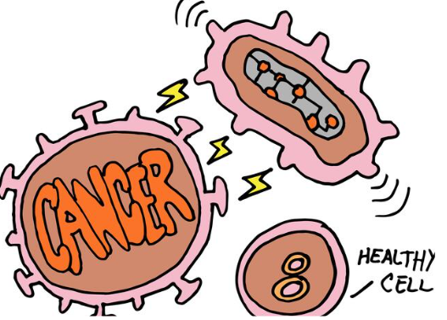
Introduction
The healthcare and medical sector are more in need of data mining today. When certain data mining methods are used in a right way, valuable information can be extracted from large database and that can help the medical practitioner to take early decision and improve health services.
Healthcare industry generate terabytes of data by analyzing of voluminous of data we can predict occurrence of disease.
Main purpose of this system is to predict disease and controlling the disease by providing accurate and trustworthy disease risk prediction

Slide 4
Abstract
01
03
Chronic diseases represent a significant global health challenge, imposing immense burdens on individuals, healthcare systems, and society as a whole. Early detection and prevention of these conditions are crucial for reducing morbidity and mortality rates. In this project, we present a predictive model designed to identify individuals at risk of developing chronic diseases based on medical history, and genetic predispositions. Through the utilization of machine learning techniques, including feature selection, model training, and evaluation, we aim to construct an accurate and reliable predictor capable of assessing an individual's susceptibility to various chronic conditions. Ethical considerations, such as data privacy and fairness, are paramount throughout the project lifecycle. By providing an efficient tool for early risk assessment and intervention, this project seeks to contribute to the advancement of personalized medicine and public health initiatives, ultimately enhancing healthcare outcomes and quality of life for individuals worldwide.

Slide 5
Literature Review
Paper Name | Author Name | Year | Summary
Disease Prediction by Machine Learning Over Big Data From Healthcare Communities | Min Chen Yixue Hao, Kai Hwang | 2022 | Developed a system which is based on patients data which is used for the prediction of multiple diseases. The sample size selected is less which affected the accuracy of the work. Method applied : Naïve bayes, Support Vector Machine

Slide 6
Literature Review
Paper Name | Author Name | Year | Summary
Identification and Prediction of Chronic Diseases Using Machine Learning Approach | Rayan Alanazi College of Science and Arts in Qurayyat, Jouf University, Sakakah | 2022 | This section describes the related works that are performed in developing the proposed model for predicting chronic diseases. The following are the discussions made by reviewing the existing literature that helps develop the proposed system efficiently and effectively. Method applied : Naïve bayes, Convolutional Neural Network

Slide 7
Literature Review
Paper Name | Author Name | Year | Summary
Prediction of Chronic diseases using Machine Learning Techniques. International journal of management, technology | Siddegowda C. J., & A. Jayanthila Devi. | 2022 | The research finds are very useful as they help health professionals. The limitations of various machine learning algorithms are also studied. Accuracy is about 85%

Slide 8
Literature Review
Paper Name | Author Name | Year | Summary
A Literature Review of Predicting Cancer Disease | Mr.A.Deivendran1 , Ms.K.Yemuna Rane M.Sc., M.Phil2 ., M.Phil Research Scholar, Dept of Computer Science, Kongunadu Arts and Science college, Coimbatore-29 | 2019 | Prediction of chronic diseases has gained prominence among the research community as it opens the lots of scope for research and development. Parameter of selection is not elaborate. Method applied : Naïve bayes, Decision Trees, Artificial neural networks and their Multilayer Perception model

Slide 9

Problem Statements
Many people suffer from chronic diseases like cancer, diabetes, and heart problems, which can have serious consequences. Detecting these diseases early can help prevent complications. Therefore, there is a need to develop an advanced chronic disease prediction framework that utilizes machine learning techniques to provide accurate and personalized risk assessments for diseases such as cancer, diabetes, and heart problems.

Slide 10


Objectives
Our aim is to provide quick medical diagnosis to the patients.
Develop a comprehensive chronic disease prediction system.
Utilize machine learning algorithms for accurate risk assessment.
Predict various chronic diseases based on
medical data.
Create a user-friendly interface for input and result visualization.

Slide 11
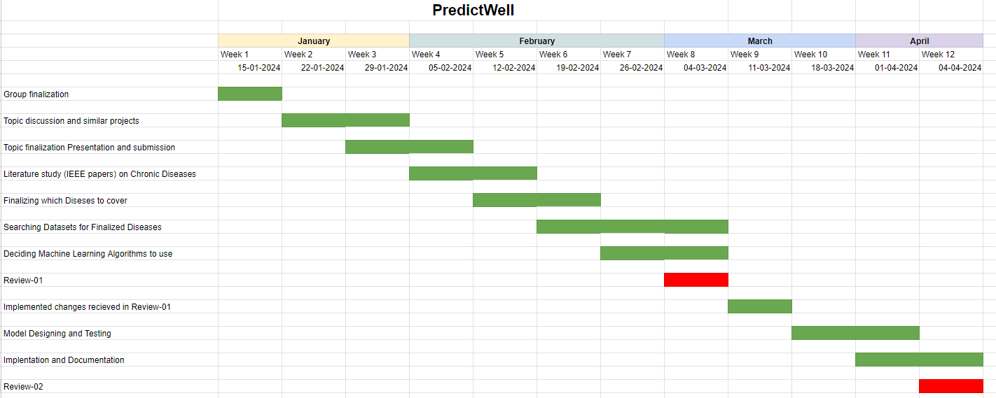
Timeline

Slide 12

Proposed system
Methodology
Two different machine learning algorithms will be applied to predict chronic diseases based on individual health data.
Random Forest : Random forest is also a type of supervised learning. It can be used both for classification and regression. It is also the most flexible and user friendly algorithm. A forest is made up of trees. It is said that the more trees it has, the more robust a forest is. Random forests create decision trees on randomly selected data samples, obtain predictions from each tree, and select the best solution by voting
Support Vector Machine (SVM) is a powerful classification algorithm used in machine learning. It identifies the best boundary, or hyperplane, that separates classes of data. By maximizing the margin between the closest data points of each class, known as support vectors, SVM ensures the most effective separation. When dealing with complex datasets that aren’t linearly separable, SVM employs the kernel trick to project the data into a higher-dimensional space where a clear division is possible. This makes SVM versatile and efficient for various classification problems

Slide 13
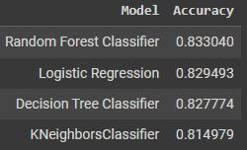
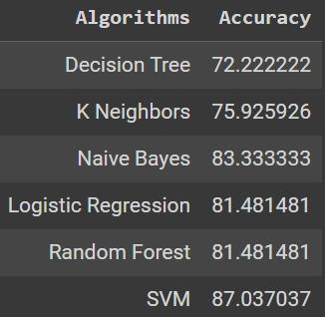
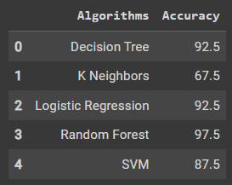
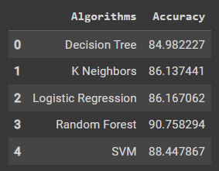
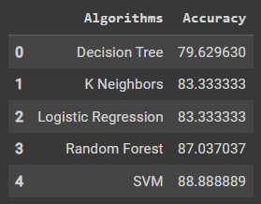
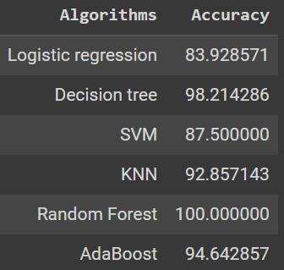
We conducted five experiments with the same data set to predict disease. The result of all the implemented algorithm are
Kidney Disease
Diabetes
Heart Disease

Slide 14
COMPARISON OF IMPLEMENTED ALGORITHMS
The purpose of our study was to use machine learning algorithms for heart disease in healthcare. So for this we performed experiment by using different algorithms on heart disease patients. Through implementation we can know which classification algorithm is best for predicting heart disease. After the implementation of different algorithms the second step is the comparison between different machine learning algorithms used in these experiments and choose the best one which gives most accuracy. In order to do comparison of these experiments different performance measures are used.
By considering accuracy of many algorithm for selected diseases we finalized
Algorithm | Disease | Accuracy (in %)
Random Forest Classifier | Diabetes | 90.7
Support Vector Machine | Heart Disease | 88.8
Random Forest Classifier | Kidney Disease | 97.5

Slide 15
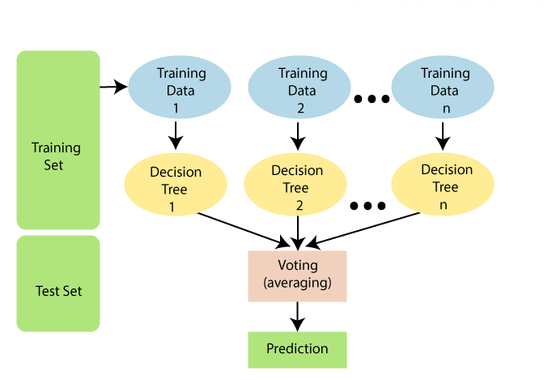
Random Forest Algorithm
80%
20%

Slide 16
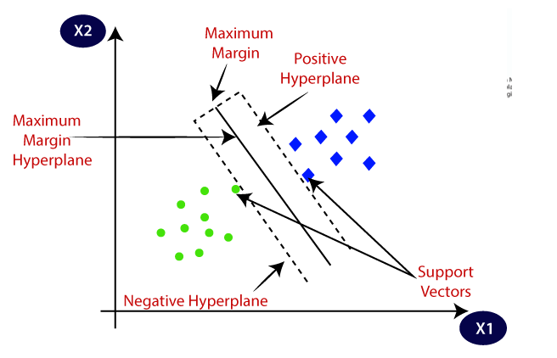
Support Vector Machine Algorithm

Slide 17
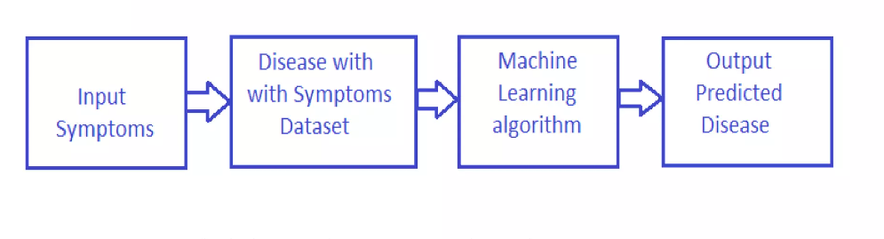
Working

Slide 18
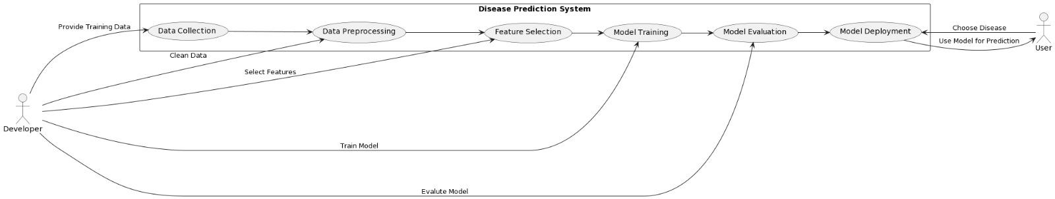
UML Diagram

Slide 19

Hardware & Software Requirements
Hardware Requirements:
CPU: Intel Core i3 or higher recommended.
GPU: Integrated GPU
RAM: At least 8GB
Software Requirements:
OS: Windows 11
Python IDE: Choose from PyCharm, Jupyter Notebook, Spyder, or Visual Studio Code.
Machine Learning Libraries: NumPy, pandas, scikit-learn, TensorFlow, Keras, Matplotlib.

Slide 20
Code
import pandas as pd
import numpy as np
import matplotlib.pyplot as plt
# %matplotlib inline
from sklearn.model_selection import train_test_split
from sklearn.ensemble import RandomForestClassifier
from sklearn.linear_model import LogisticRegression
from sklearn.metrics import accuracy_score, classification_report, confusion_matrix, mean_squared_error
from sklearn.neighbors import KNeighborsClassifier
from sklearn.tree import DecisionTreeClassifier
from mlxtend.plotting import plot_confusion_matrix
from sklearn import tree
import math
import warnings
import matplotlib.pyplot as plt
import seaborn as sns
import numpy as np
warnings.filterwarnings('ignore')
diabetes = pd.read_csv("/content/Diabetes.csv")

Slide 21
diabetes = pd.read_csv("/content/Diabetes.csv")
diabetes
print(diabetes.columns)
#for first 5 rows
diabetes.head()
#for last 5 rows
diabetes.tail()
#no of rows and columns
diabetes.shape
#getting info about data
diabetes.info()
diabetes.isnull().sum()
#statistical measures about the data
diabetes.describe
x=diabetes.drop(columns='Diabetes_012',

Slide 22
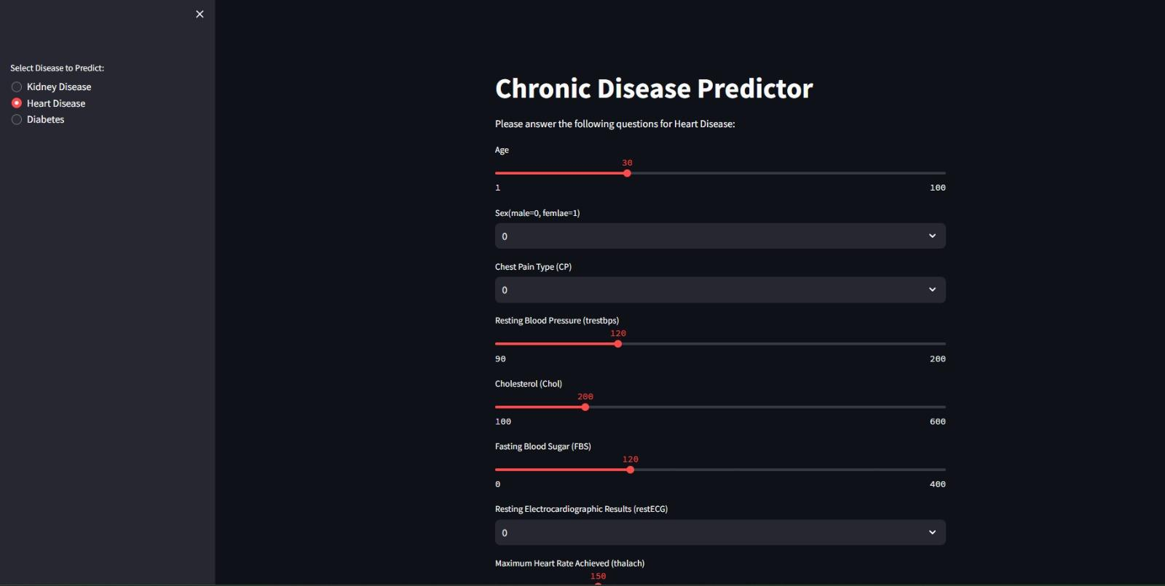
Result

Slide 23


Slide 24
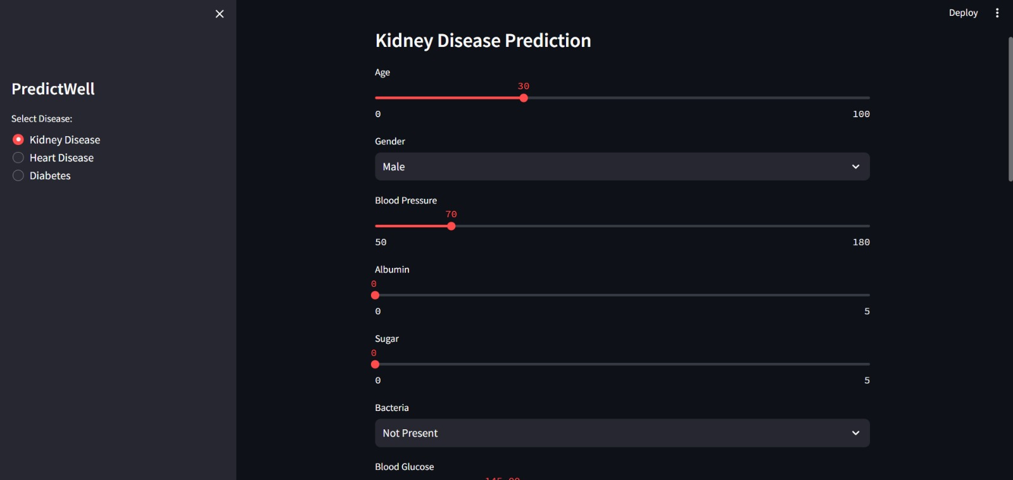
Kidney Disease

Slide 25
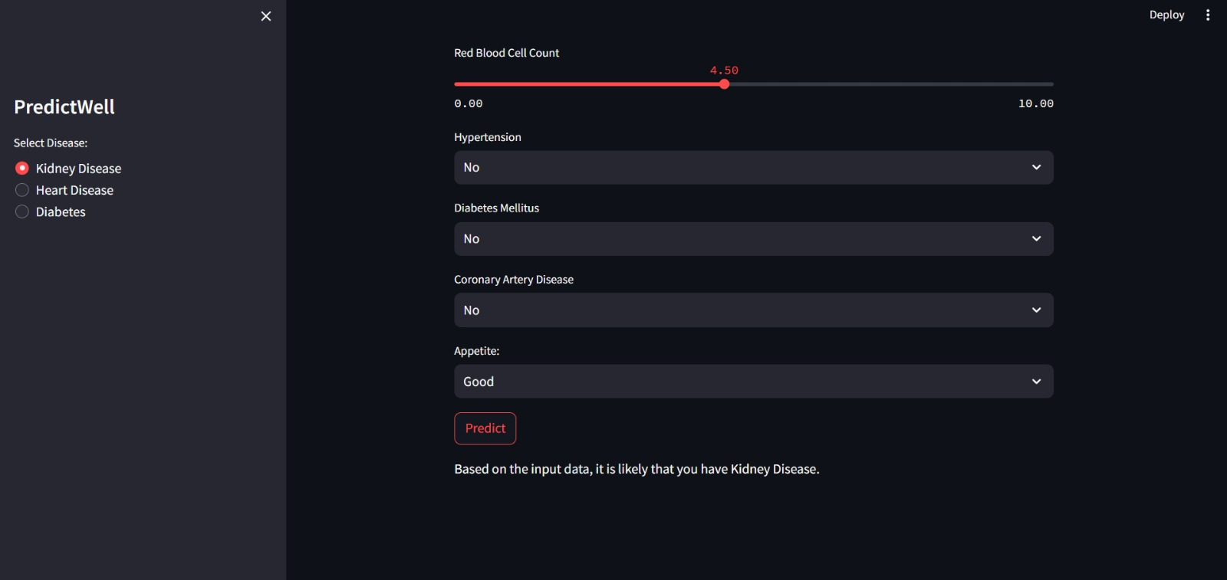

Slide 26
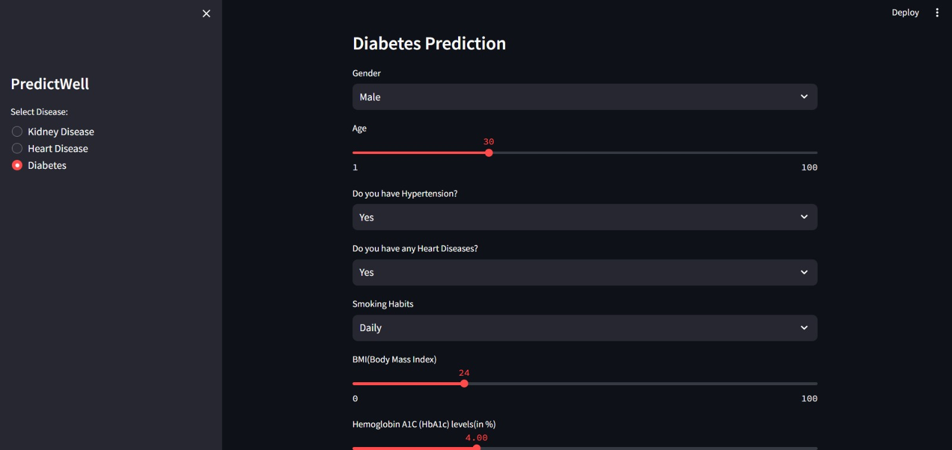
Diabetes

Slide 27
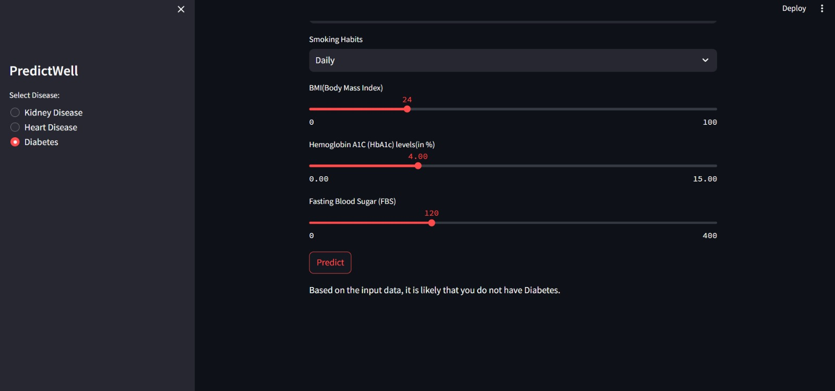

Slide 28
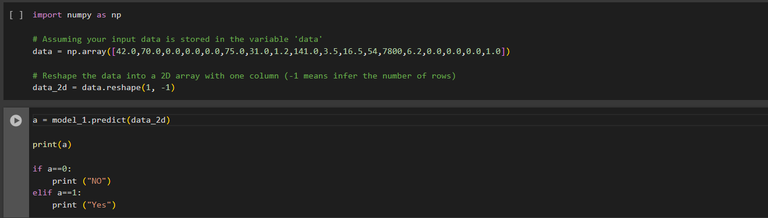
Testing Kidney Disease

Slide 29
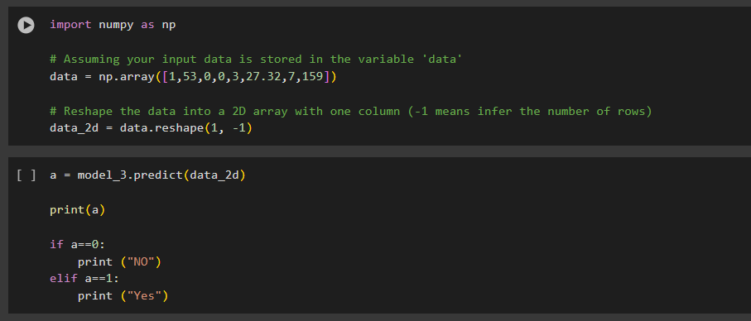
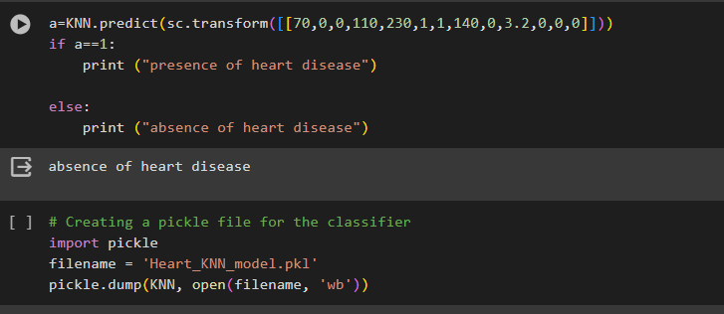
Testing of Diabetes
Testing of Heart Disease

Slide 30

Conclusion
This project proposed a method of identification and prediction of the presence of chronic disease in an individual using the machine learning algorithms by Random forest and SVM. The advantage of the proposed system is the use of both structured data and real life for data set preparation, which lacks in many of the existing approaches.
It is highly believed that the proposed system can reduce the risk of chronic diseases by diagnosing them earlier and also reduces the cost for diagnosis, treatment, and doctor consultation.But for now as per the build software it can only predict for three diseases ie. Diabetes, Kidney Diseases, Heart Diseases.

Slide 31
References
Ambekar, S., & Phalnikar, R. (2018, August). Disease risk prediction by using convolutional neural network. In 2018 Fourth international conference on computing communication .An improved method for disease prediction using fuzzy approach. In 2015 www.event management.org
Wadhwa, S., &Babber, K. (2020, July). Artificial intelligence in healthcare: predictive analysis on diabetes using machine learning algorithms. In International Conference on Computational Science and Its Application
Disease Prediction by Machine Learning Over Big Data From Healthcare Communities
A Literature Review of Predicting Cancer Disease by Rayan Alanazi College of Science and Arts Qurayyat, Jouf University, Sakakah.
A Literature Review of Predicting Cancer Disease Mr.A.Deivendran1 , Ms.K.Yemuna Rane M.Sc., M.Phil2 ., M.Phil
Prediction of Chronic diseases using Machine Learning Techniques. International journal of management, technology

Slide 32

Thank you

